Slide 1
Green University of Bangladesh
Department of Computer Science & Engineering
Subject: Data Structure
Course Code: CSE106
Our Presentation topic : Stack
Submitted To:
Name: Ansarul Islam
Designation: Lecturer
Department: CSE
Green university of Bangladesh
Submitted by:
Name: Jakirul Islam
ID:193002101
Name: Nazifa Aalam Nowrin
ID:193002103

Slide 3
PROS & CONS
Pros:
• Precision and Accuracy
• Space exploration
• Used for mining process
• Can do laborious tasks
• Fraud detection, manage records.
• Lacking the emotional side
• Can do repetitive and time-consuming tasks
• Robotic pets, Robotic radiosurgery.
• Function without stopping, Risk Reducing.
• Diagnosis and Treatment
CONS :
▪ Cost incurred in the maintenance and repair
▪ Not able to act any different
▪ Lack the human touch
▪ Lack a creative mind
▪ Lack common sense
▪ Unemployment
▪ Abilities of humans may diminish
.
▪ Robots superseding humans
.
▪ Humans may became dependent on machines.
▪ Wrong hands causes destruction

Slide 4
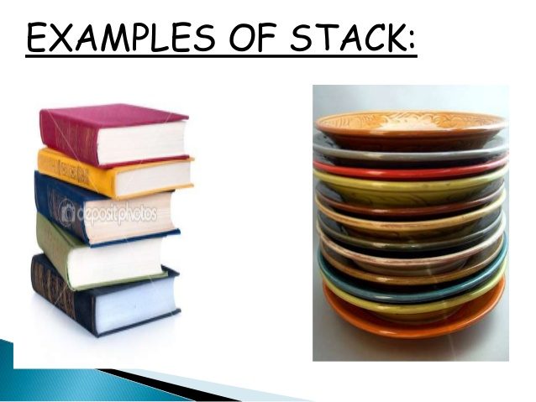
Introduction:
A stack is a data structure that stores data in such a way that the last piece of data stored, is the first one retrieved. LAST IN FIRST OUT =LIFO To get the bottom plate out, you must first remove all the plates above.

Slide 5
Stack Operations
Top: Open end of the stack is called Top, From this end item can be inserted.
Push:To insert an item from Top of stack is called push operation. The push operation change the position of Top in stack.
POP: To put-off, get or remove some item from top of the stack is the pop operation, We can POP only only from top of the stack.
IsEmpty: Stack considered empty when there is no item on Top. IsEmpty operation return true when no item in stack else false.
IsFull: Stack considered full if no other element can be inserted on top of the stack. This condition normally occur when stack implement ed through array.

Slide 6
APPLICATIONS OF STACKS :
Reversing Strings:
A simple application of stack is reversing strings. To reverse a string , the characters of string are pushed onto the stack one by one as the string is read from left to right.
Once all the characters of string are pushed onto stack, they are popped one by one. Since the character last pushed in comes out first, subsequent pop operation results in the reversal of the string.

Slide 7


